Slide 1
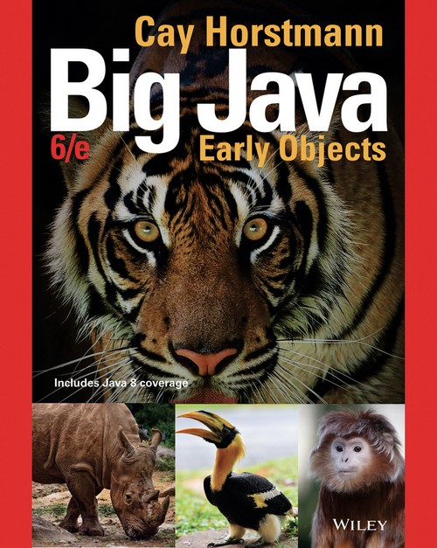
Chapter 4 – Fundamental Data Types

Slide 2
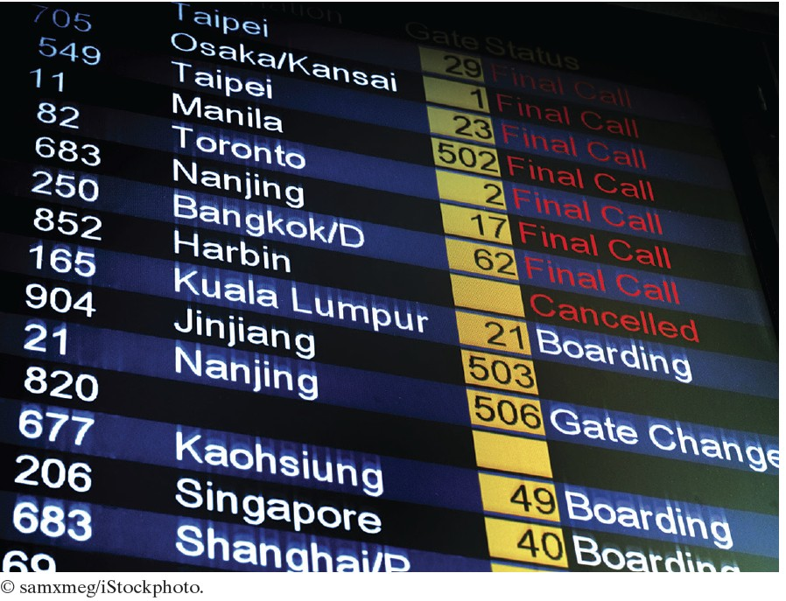
Chapter Goals
To understand integer and floating-point numbers To recognize the limitations of the numeric types
To become aware of causes for overflow and roundoff errors To understand the proper use of constants
To write arithmetic expressions in Java
To use the String type to manipulate character strings
To write programs that read input and produce formatted output

Slide 3
Number Types
Every value in Java is either:
a reference to an object
one of the eight primitive types
Java has eight primitive types:
four integer types
two floating-point types two other

Slide 4
Primitive Types
Type
Description
The integer type, with range -2,147,483,648 (Integer.MIN_VALUE) . . . 2,147,483,647 (Integer.MAX_VALUE)
The type describing a single byte, with range -128 . . . 127
Size
4
bytes
1
byte
2
bytes
8
bytes
8
bytes
4
bytes
2
Bytes
1 bit
int
byte
short
The short integer type, with range -32768 . . . 32767
long
The long integer type, with range -9,223,372,036,854,775,808 . . .
9,223,372,036,854,775,807
The double-precision floating-point type, with a range of about ±10³⁰⁸ and about 15 significant decimal digits
The single-precision floating-point type, with a range of about ±10³⁸ and about 7 significant decimal digits
double
float
char
The character type, representing code units in the Unicode encoding scheme
boolean
The type with the two truth values false and true

Slide 5
Number Literals
A number that appears in your code If it has a decimal, it is floating point If not, it is an integer

Slide 6
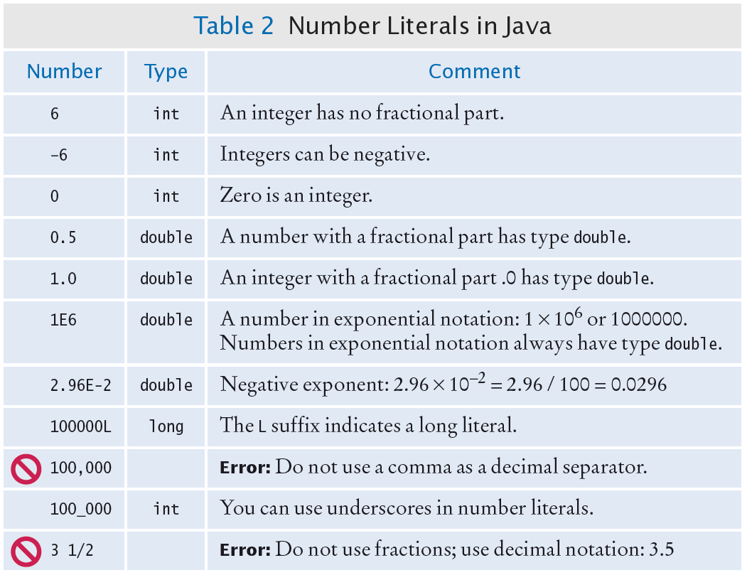
Number Literals

Slide 7

Overflow
Generally use an int for integers Overflow occurs when
The result of a computation exceeds the range for the number type
Example
int n = 1000000;
System.out.println(n * n); // Prints –727379968,
// which is clearly wrong
10¹² is larger that the largest int The result is truncated to fit in an int No warning is given
Solution: use long instead
Generally do not have overflow with the double data type

Slide 8

Rounding Errors
Rounding errors occur when an exact representation of a floating-point number is not possible.
Floating-point numbers have limited precision. Not every value can be represented precisely, and roundoff errors can occur.
Example
double f = 4.35;
System.out.println(100 * f); // Prints 434.99999999999994
Use double type in most cases

Slide 9
Constants: final
Use symbolic names for all values, even those that appear obvious. A final variable is a constant
Once its value has been set, it cannot be changed
Named constants make programs easier to read and maintain. Convention: use all-uppercase names for constants:
final double QUARTER_VALUE = 0.25; final double DIME_VALUE = 0.1; final double NICKEL_VALUE = 0.05; final double PENNY_VALUE = 0.01;
payment = dollars + quarters * QUARTER_VALUE + dimes * DIME_VALUE
+ nickels * NICKEL_VALUE + pennies * PENNY_VALUE;

Slide 10
Constants: static final
If constant values are needed in several methods,
Declare them together with the instance variables of a class Tag them as static and final
The static reserved word means that the constant belongs to the class
Give static final constants public access to enable other classes to use them: Declaration of constants in the Math class
public class Math
{
. . .
public static final double E = 2.7182818284590452354; public static final double PI = 3.14159265358979323846;
}
Using a constant
double circumference = Math.PI * diameter;

Slide 11
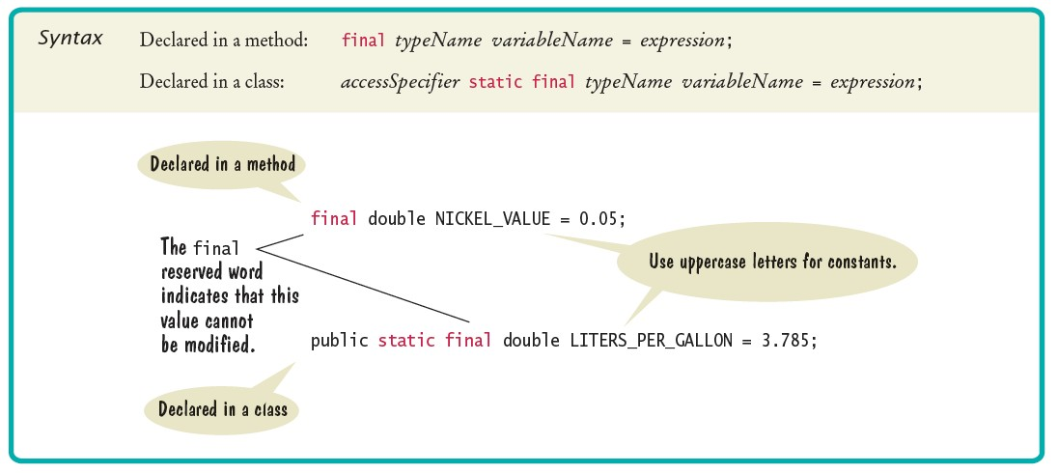
Syntax 4.1 Constant Declaration

Slide 12
section_1/CashRegister.java
1 /**
2 A cash register totals up sales and computes change due.
3 */
4 public class CashRegister
5 {
public static final double QUARTER_VALUE = 0.25;
public static final double DIME_VALUE = 0.1;
public static final double NICKEL_VALUE = 0.05;
public static final double PENNY_VALUE = 0.01;
10
11
12
13
14
15
16
17
18
19
20
21
22
23
24
25
26
27
28
29
30
31
32
33
34
35
private double purchase; private double payment;
/**
Constructs a cash register with no money in it.
*/
public CashRegister()
{
purchase = 0;
payment = 0;
}
/**
Records the purchase price of an item.
@param amount the price of the purchased item
*/
public void recordPurchase(double amount)
{
purchase = purchase + amount;
}
/**
Processes the payment received from the customer.
@param dollars the number of dollars in the payment
@param quarters the number of quarters in the payment

Slide 13
section_1/CashRegisterTester.java
1 /**
2 This class tests the CashRegister class.
3 */
4 public class CashRegisterTester
5 {
6 public static void main(String[] args)
7 {
8 CashRegister register = new CashRegister();
9
10
11
12
13
14
15
16
17
18
19
20
21
22
23
24 }
register.recordPurchase(0.75); register.recordPurchase(1.50); register.receivePayment(2, 0, 5, 0, 0); System.out.print("Change: "); System.out.println(register.giveChange()); System.out.println("Expected: 0.25");
register.recordPurchase(2.25); register.recordPurchase(19.25); register.receivePayment(23, 2, 0, 0, 0); System.out.print("Change: "); System.out.println(register.giveChange()); System.out.println("Expected: 2.0");
}
Program Run:
Change: 0.25
Expected: 0.25
Change: 2.0
Expected: 2.0

Slide 14
Self Check 4.1
Which are the most commonly used number types in Java?
Answer: int and double

Slide 15
Self Check 4.2
Suppose you want to write a program that works with population data from various countries. Which Java data type should you use?
Answer: The world’s most populous country, China, has about 1.2 x 10⁹ inhabitants. Therefore, individual population counts could be held in an int. However, the world
population is over 6 × 10⁹. If you compute totals or averages of multiple countries, you can exceed the largest int value. Therefore, double is a better choice. You could also use long, but there is no benefit because the exact population of a country is not known at any point in time.

Slide 16
Self Check 4.3
Which of the following initializations are incorrect, and why?
int dollars = 100.0;
double balance = 100;
Answer: The first initialization is incorrect. The right hand side is a value of type double, and it is not legal to initialize an int variable with a double value. The second initialization is correct — an int value can always be converted to a double.

Slide 17
Self Check 4.4
What is the difference between the following two statements?
final double CM_PER_INCH = 2.54;
and
public static final double CM_PER_INCH = 2.54;
Answer: The first declaration is used inside a method, the second inside a class.

Slide 18
Self Check 4.5
What is wrong with the following statement sequence?
double diameter = . . .;
double circumference = 3.14 * diameter;
Answer: Two things
You should use a named constant, not the “magic number” 3.14
3.14 is not an accurate representation of π.

Slide 19
Arithmetic Operators
Four basic operators:
addition: + subtraction: - multiplication: * division: /
Expression: combination of variables, literals, operators, and/or method calls
(a + b) / 2
Parentheses control the order of the computation
(a + b) / 2
Multiplication and division have a higher precedence than addition and subtraction
a + b / 2
Mixing integers and floating-point values in an arithmetic expression yields a floating- point value
7 + 4.0 is the floating-point value 11.0

Slide 20
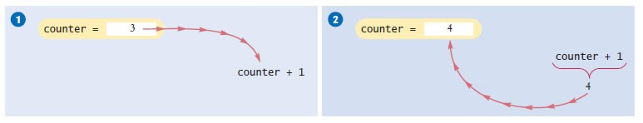
Increment and Decrement
The ++ operator adds 1 to a variable (increments)
counter++; // Adds 1 to the variable counter
The -- operator subtracts 1 from the variable (decrements)
counter--; // Subtracts 1 from counter
Figure 1 Incrementing a Variable

Slide 21
Integer Division and Remainder
Division works as you would expect, as long as at least one of the numbers is a floating-point number.
Example: all of the following evaluate to 1.75
7.0 / 4.0
7 / 4.0
7.0 / 4
If both numbers are integers, the result is an integer. The remainder is discarded
7 / 4 evaluates to 1
Use % operator to get the remainder with (pronounced "modulus", "modulo", or "mod")
7 % 4 is 3

Slide 22
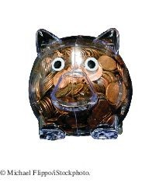
Integer Division and Remainder
To determine the value in dollars and cents of 1729 pennies
Obtain the dollars through an integer division by 100
int dollars = pennies / 100; // Sets dollars to 17
To obtain the remainder, use the % operator
int cents = pennies % 100; // Sets cents to 29
Integer division and the % operator yield the dollar and cent values of a piggybank full of pennies.

Slide 23
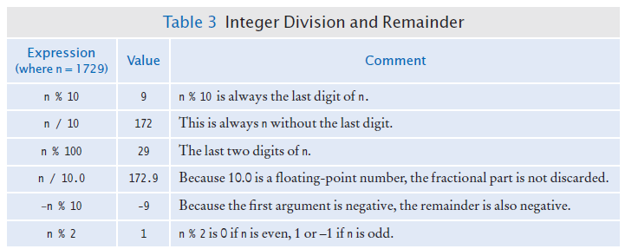
Integer Division and Remainder

Slide 24

Powers and Roots
Math class contains methods sqrt and pow to compute square roots and powers To take the square root of a number, use Math.sqrt; for example, Math.sqrt(x)
To compute x^{n}, you write Math.pow(x, n)
To compute x² it is significantly more efficient simply to compute x * x
In Java,
can be represented as
b * Math.pow(1 + r / 100, n)

Slide 25
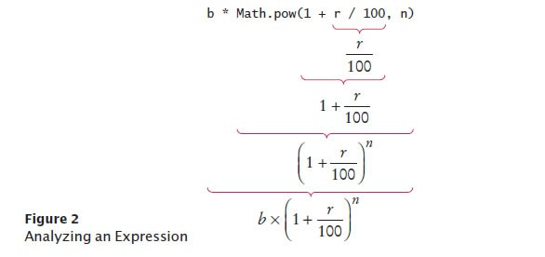
Analyzing an Expression

Slide 26
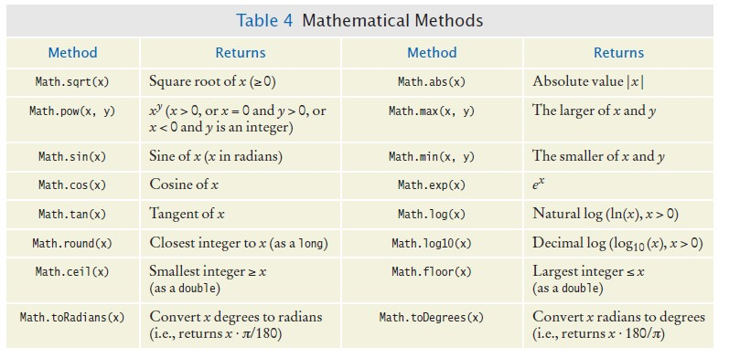
Mathematical Methods

Slide 27
Converting Floating-Point Numbers to Integers - Cast
The compiler disallows the assignment of a double to an int because it is potentially dangerous
The fractional part is lost
The magnitude may be too large This is an error
double balance = total + tax;
int dollars = balance; // Error: Cannot assign double to int
Use the cast operator (int) to convert a convert floating-point value to an integer.
double balance = total + tax; int dollars = (int) balance;
Cast discards fractional part
You use a cast (typeName) to convert a value to a different type.

Slide 28
Converting Floating-Point Numbers to Integers - Rounding
Math.round converts a floating-point number to nearest integer:
long rounded = Math.round(balance);
If balance is 13.75, then rounded is set to 14.

Slide 29
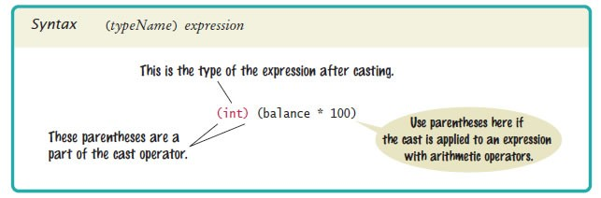
Syntax 4.2 Cast

Slide 30
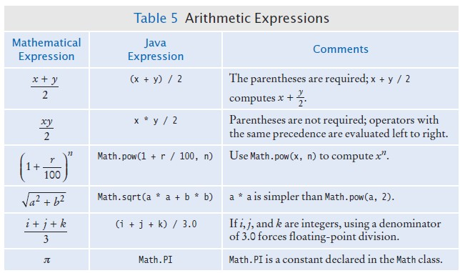
Arithmetic Expressions

Slide 31
Self Check 4.6
A bank account earns interest once per year. In Java, how do you compute the interest earned in the first year? Assume variables percent and balance of type double have already been declared.
Answer: double interest = balance * percent / 100;

Slide 32
Self Check 4.7
In Java, how do you compute the side length of a square whose area is stored in the variable area?
Answer: double sideLength = Math.sqrt(area);

Slide 33

Self Check 4.8
The volume of a sphere is given by
If the radius is given by a variable radius of type double, write a Java expression for the volume.
Answer:
4 * PI * Math.pow(radius, 3) / 3
or (4.0 / 3) * PI * Math.pow(radius, 3),
but not (4 / 3) * PI * Math.pow(radius, 3)

Slide 34
Self Check 4.9
What are the values of 1729 / 100 and 1729 % 100?
Answer: 17 and 29

Slide 35
Self Check 4.10
If n is a positive number, what is (n / 10) % 10?
Answer: It is the second-to-last digit of n. For example, if n is 1729, then n / 10 is 172, and (n / 10) % 10 is 2.

Slide 36

Calling Static Methods
Can not call a method on a number type
double root = 2.sqrt(); // Error
Use a static method instead.
A static method does not operate on an object:
double root = Math.sqrt(2); // Correct
Static methods are declared inside classes Calling a static method:

Slide 37
Reading Input
When a program asks for user input
It should first print a message that tells the user which input is expected
System.out.print("Please enter the number of bottles: "); // Display prompt
This message is called a prompt
Use the print method, not println, to display the prompt Leave a space after the colon
System.in has minimal set of features
Must be combined with other classes to be useful
Use a class called Scanner to read keyboard input.

Slide 38
Reading Input - Scanner
To obtain a Scanner object:
Scanner in = new Scanner(System.in);
Use the Scanner's nextInt method to read an integer value:
System.out.print("Please enter the number of bottles: "); int bottles = in.nextInt();
When the nextInt method is called,
The program waits until the user types a number and presses the Enter key; After the user supplies the input, the number is placed into the bottles variable; The program continues.
Use the nextDouble method to read a floating-point number:
System.out.print("Enter price: "); double price = in.nextDouble();
To use the Scanner class, import it by placing the following at the top of your program file:
import java.util.Scanner;

Slide 39
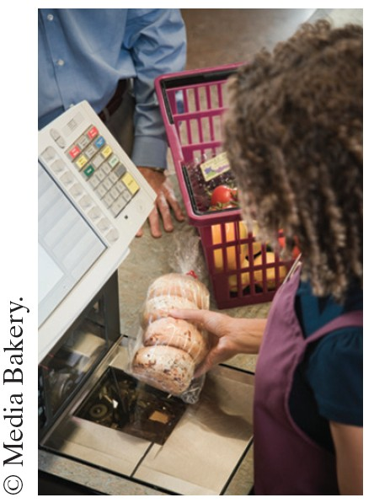
Reading Input
A supermarket scanner reads bar codes. The Java Scanner reads numbers and text.

Slide 40
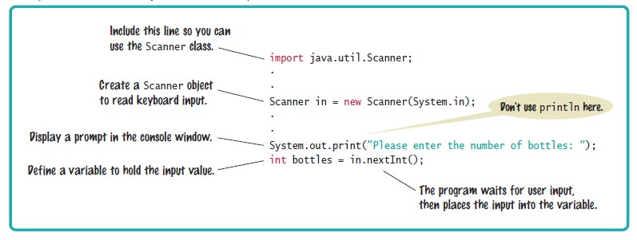
Syntax 4.3 Input Statement

Slide 41
Formatted Output
Use the printf method to specify how values should be formatted.
Printf lets you print this
Price per liter: 1.22
Instead of this
Price per liter: 1.215962441314554
This command displays the price with two digits after the decimal point:
System.out.printf("%.2f", price);

Slide 42

Formatted Output
You can also specify a field width:
System.out.printf("%10.2f", price);
This prints 10 characters
Six spaces followed by the four characters 1.22
This command
System.out.printf("Price per liter:%10.2f", price);
Prints
Price per liter: 1.22

Slide 43
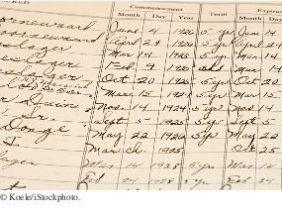
Formatted Output
You use the printf method to line up your output in neat columns.

Slide 44
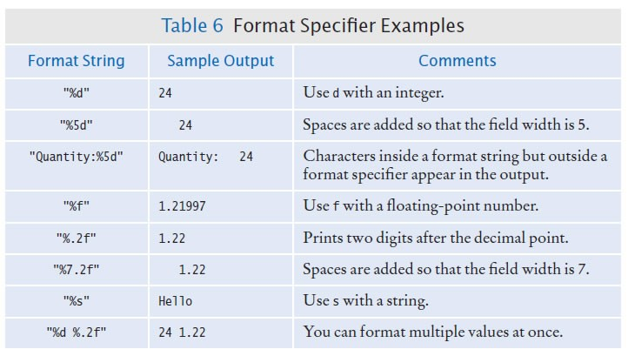
Formatted Output

Slide 45
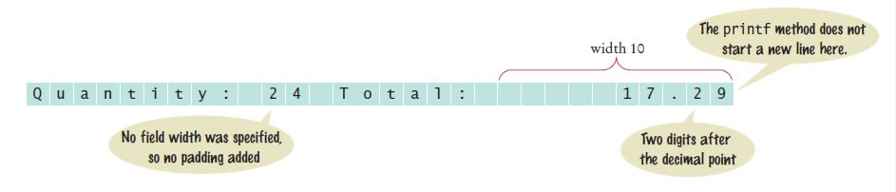
Formatted Output
You can print multiple values with a single call to the printf method. Example
System.out.printf("Quantity: %d Total: %10.2f", quantity, total);
Output explained:

Slide 46
section_3/Volume.java
1 import java.util.Scanner;
2
3 /**
4 This program prints the price per liter for a six-pack of cans and
5 a two-liter bottle.
6 */
7 public class Volume
8 {
9 public static void main(String[] args)
10 {
11 // Read price per pack
12
13
14
15
16
17
18
19
20
21
22
23
24
25
26
27
28
29
30
31
32
33
34
35
Scanner in = new Scanner(System.in);
System.out.print("Please enter the price for a six-pack: "); double packPrice = in.nextDouble();
// Read price per bottle
System.out.print("Please enter the price for a two-liter bottle: "); double bottlePrice = in.nextDouble();
final double CANS_PER_PACK = 6;
final double CAN_VOLUME = 0.355; // 12 oz. = 0.355 l
final double BOTTLE_VOLUME = 2;
// Compute and print price per liter
double packPricePerLiter = packPrice / (CANS_PER_PACK * CAN_VOLUME); double bottlePricePerLiter = bottlePrice / BOTTLE_VOLUME;
System.out.printf("Pack price per liter: %8.2f", packPricePerLiter); System.out.println();
Program Run:
System.out.printf("Bottle price per liter: %8.2f", bottlePricePerLiter);
Please enter the price for a six-pack: 2.95
Please enter the price for a two-liter bottle: 2.85 Pack price per liter: 1.38
Bottle price per liter: 1.43

Slide 47
Self Check 4.11
Write statements to prompt for and read the user’s age using a Scanner variable named in.
Answer:
System.out.print("How old are you? "); int age = in.nextInt();

Slide 48
Self Check 4.12
What is wrong with the following statement sequence?
System.out.print("Please enter the unit price: "); double unitPrice = in.nextDouble();
int quantity = in.nextInt();
Answer: There is no prompt that alerts the program user to enter the quantity.

Slide 49
Self Check 4.13
What is problematic about the following statement sequence?
System.out.print("Please enter the unit price: "); double unitPrice = in.nextInt();
Answer: The second statement calls nextInt, not nextDouble. If the user were to enter a price such as 1.95, the program would be terminated with an “input mismatch exception”.

Slide 50
Self Check 4.14
What is problematic about the following statement sequence?
System.out.print("Please enter the number of cans"); int cans = in.nextInt();
Answer: There is no colon and space at the end of the prompt. A dialog would look like this:
Please enter the number of cans6

Slide 51
Self Check 4.15
What is the output of the following statement sequence?
int volume = 10;
System.out.printf("The volume is %5d", volume);
Answer: The total volume is 10
There are four spaces between is and 10. One space originates from the format string (the space between s and %), and three spaces are added before 10 to achieve a field width of 5.

Slide 52
Self Check 4.16
Using the printf method, print the values of the integer variables bottles and cans so that the output looks like this:
Bottles: Cans:
8
24
The numbers to the right should line up. (You may assume that the numbers have at most 8 digits.)
Answer: Here is a simple solution:
System.out.printf("Bottles: %8d\n", bottles); System.out.printf("Cans: %8d\n", cans);
Note the spaces after Cans:. Alternatively, you can use format specifiers for the strings. You can even combine all output into a single statement:
System.out.printf("%-9s%8d\n%-9s%8d\n", "Bottles: ", bottles, "Cans:", cans);

Slide 53
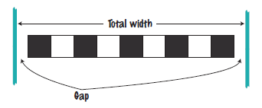

Problem Solving: First Do It By Hand
Very important step for developing an algorithm
Carry out the computations by hand first
Pick concrete values for a typical situation to use in a hand calculation.
Problem: A row of black and white tiles needs to be placed along a wall. First and last are black.
Compute the number of tiles needed and the gap at each end, given the space available and the width of each tile.
Use numbers
Total width: 100 inches Tile width: 5 inches
The first tile must always be black,
and then we add some number of white/black pairs:

Slide 54
Problem Solving: First Do It By Hand
The first tile takes up 5 inches, leaving 95 inches to be covered by pairs.
Each pair is 10 inches wide.
The number of pairs needed is 95 / 10 = 9.5. Discard the fractional part.
We need 9 tile pairs or 18 tiles, plus the initial black tile => 19 tiles.
Tiles span 19 × 5 = 95 inches
Gap is 100 – 19 × 5 = 5 inches
Distribute the gap at both ends
gap is (100 – 19 × 5) / 2 = 2.5 inches

Slide 55
Problem Solving: First Do It By Hand
Devise an algorithm with arbitrary values for the total width and tile width. The pseudocode
number of pairs = integer part of (total width - tile width) / (2 x tile width) number of tiles = 1 + 2 x number of pairs
gap at each end = (total width - number of tiles x tile width) / 2

Slide 56
Self Check 4.17
Translate the pseudocode for computing the number of tiles and the gap width into Java.
Answer:
int pairs = (totalWidth - tileWidth) / (2 * tileWidth); int tiles = 1 + 2 * pairs;
double gap = (totalWidth - tiles * tileWidth) / 2.0;
Be sure that pairs is declared as an int.

Slide 57

Self Check 4.18
Suppose the architect specifies a pattern with black, gray, and white tiles, like this:
Again, the first and last tile should be black. How do you need to modify the algorithm?
Answer: Now there are groups of four tiles (gray/ white/gray/black) following the initial black tile. Therefore, the algorithm is now
number of groups = integer part of (total width - tile width) /(4 x tile width) number of tiles = 1 + 4 x number of groups
The formula for the gap is not changed.

Slide 58
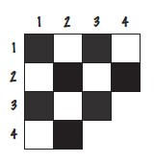
Self Check 4.19
A robot needs to tile a floor with alternating black and white tiles. Develop an algorithm that yields the color (0 for black, 1 for white), given the row and column number. Start with specific values for the row and column, and then generalize.
Answer: The answer depends only on whether the row and column numbers are even or odd, so let’s first take the remainder after dividing by 2. Then we can enumerate all expected answers:
Rows%2 | Columns%2 | Color
0 | 0 | 0
0 | 1 | 1
1 | 0 | 1
1 | 1 | 0
In the first three entries of the table, the color is simply the sum of the remainders. In
the fourth entry, the sum would be 2, but we want a zero. We can achieve that by taking another remainder operation:
color = ((row % 2) + (column % 2)) % 2

Slide 59
Self Check 4.20
For a particular car, repair and maintenance costs in year 1 are estimated at $100; in year 10, at $1,500. Assuming that the repair cost increases by the same amount every year, develop pseudocode to compute the repair cost in year 3 and then generalize to year n.
Answer: In nine years, the repair costs increased by $1,400. Therefore, the increase per year is $1,400 / 9 ≈ $156. The repair cost in year 3 would be $100 + 2 x $156 =
$412. The repair cost in year n is $100 + n x $156. To avoid accumulation of roundoff errors, it is actually a good idea to use the original expression that yielded $156, that is,
Repair cost in year n = 100 + n x 1400 / 9

Slide 60


Self Check 4.21
The shape of a bottle is approximated by two cylinders of radius r₁ and r₂ and heights h₁ and h₂, joined by a cone section of height h₃.
Using the formulas for the volume of a cylinder, V = π r² h, and a cone section
develop pseudocode to compute the volume of the bottle. Using an actual bottle with known volume as a sample, make a hand calculation of your pseudocode.
Answer: The pseudocode follows from the equations:
Measuring a typical wine bottle yields
r₁ = 3.6, r₂ = 1.2, h₁ = 15, h₂ = 7, h₃ = 6 (all in centimeters).
Therefore,
bottom volume = 610.73 top volume = 31.67 middle volume = 135.72 total volume = 778.12
The actual volume is 750 ml, which is close enough to our computation to give confidence that it is correct.

Slide 61
String Type
A string is a sequence of characters.
You can declare variables that hold strings
String name = "Harry";
A string variable is a variable that can hold a string
String literals are character sequences enclosed in quotes A string literal denotes a particular string
"Harry"
String length is the number of characters in the string
The length of "Harry" is 5
The length method yields the number of characters in a string
int n = name.length();
A string of length 0 is called the empty string
Contains no characters Is written as ""

Slide 62
Concatenation
Concatenating strings means to put them together to form a longer string Use the + operator:
Example:
String fName = "Harry"; String lName = "Morgan"; String name = fName + lName;
Result:
"HarryMorgan"
To separate the first and last name with a space
String name = fName + " " + lName;
Results in
"Harry Morgan"

Slide 63
Concatenation
If one of the arguments of the + operator is a string
The other is forced to become to a string: Both strings are then concatenated
Example
String jobTitle = "Agent"; int employeeId = 7;
String bond = jobTitle + employeeId;
Result
"Agent7"

Slide 64
Concatenation in Print Statements
Useful to reduce the number of System.out.print instructions
System.out.print("The total is "); System.out.println(total);
versus
System.out.println("The total is " + total);

Slide 65
String Input
Use the next method of the Scanner class to read a string containing a single word.
System.out.print("Please enter your name: "); String name = in.next();
Only one word is read.
Use a second call to in.next to get a second word.

Slide 66
Escape Sequences
To include a quotation mark in a literal string, precede it with a backslash ( \ )
"He said \"Hello\""
Indicates that the quotation mark that follows should be a part of the string and not mark the end of the string
Called an escape sequence
To include a backslash in a string, use the escape sequence \\
"C:\\Temp\\Secret.txt"
A newline character is denoted with the escape sequence \n
A newline character is often added to the end of the format string when using
System.out.printf:
System.out.printf("Price: %10.2f\n", price);

Slide 67

Strings and Characters
A string is a sequences of Unicode characters. A character is a value of the type char.
Characters have numeric values
Character literals are delimited by single quotes.
'H' is a character. It is a value of type char
Don't confuse them with strings
"H" is a string containing a single character. It is a value of type String.

Slide 68

Strings and Characters
String positions are counted starting with 0.
The position number of the last character is always one less than the length of the string.
The last character of the string "Harry" is at position 4 The charAt method returns a char value from a string The example
String name = "Harry";
char start = name.charAt(0); char last = name.charAt(4);
Sets start to the value 'H' and last to the value 'y'.

Slide 69


Substrings
Use the substring method to extract a part of a string. The method call str.substring(start, pastEnd)
returns a string that is made up of the characters in the string str,
starting at position start, and
containing all characters up to, but not including, the position pastEnd.
Example:
String greeting = "Hello, World!";
String sub = greeting.substring(0, 5); // sub is "Hello"
To extract "World"
String sub2 = greeting.substring(7, 12);
Substring length is “past the end” - start

Slide 70
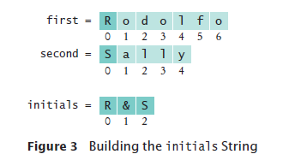
Substrings
If you omit the end position when calling the substring method, then all characters from the starting position to the end of the string are copied.
Example
String tail = greeting.substring(7);
// Copies all characters from position 7 on
Result
Sets tail to the string "World!".
To make a string of one character, taken from the start of first
first.substring(0, 1)

Slide 71
section_5/Initials.java
1 import java.util.Scanner;
2
3 /**
4 This program prints a pair of initials.
5 */
6 public class Initials
7 {
8 public static void main(String[] args)
9 {
10 Scanner in = new Scanner(System.in);
11
12
13
14
15
16
17
18
19
20
21
22
23
24
25 }
// Get the names of the couple
System.out.print("Enter your first name: "); String first = in.next();
System.out.print("Enter your significant other's first name: "); String second = in.next();
// Compute and display the inscription
String initials = first.substring(0, 1)
+ "&" + second.substring(0, 1); System.out.println(initials);
}
Program Run:
Enter your first name: Rodolfo
Enter your significant other's first name: Sally R&S

Slide 72
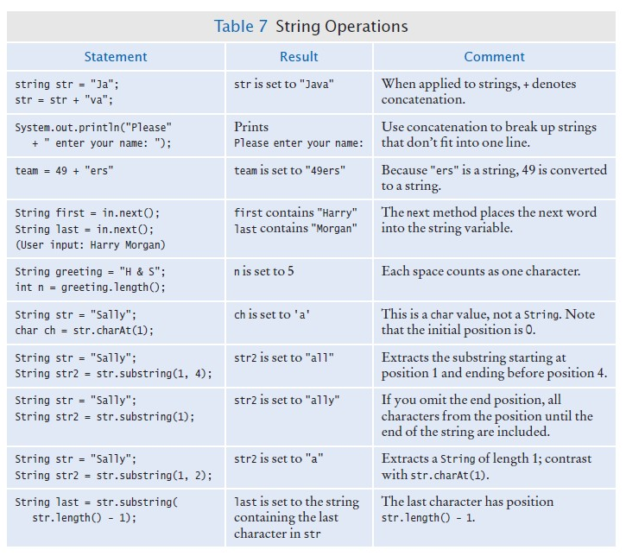
String Operations

Slide 73
Self Check 4.22
What is the length of the string "Java Program"?
Answer: The length is 12. The space counts as a character.

Slide 74
Self Check 4.23
Consider this string variable
String str = "Java Program";
Give a call to the substring method that returns the substring "gram".
Answer: str.substring(8, 12) or str.substring(8)

Slide 75
Self Check 4.24
Use string concatenation to turn the string variable str from Self Check 23 into "Java Programming".
Answer: str = str + "ming";

Slide 76
Self Check 4.25
What does the following statement sequence print?
String str = "Harry"; int n = str.length();
String mystery = str.substring(0, 1) + str.substring(n - 1, n); System.out.println(mystery);;
Answer: Hy

Slide 77
Self Check 4.26
Give an input statement to read a name of the form “John Q. Public”.
Answer:
String first = in.next(); String middle = in.next(); String last = in.next();

Slide 78

International Alphabets and Unicode: German Keyboard

Slide 79
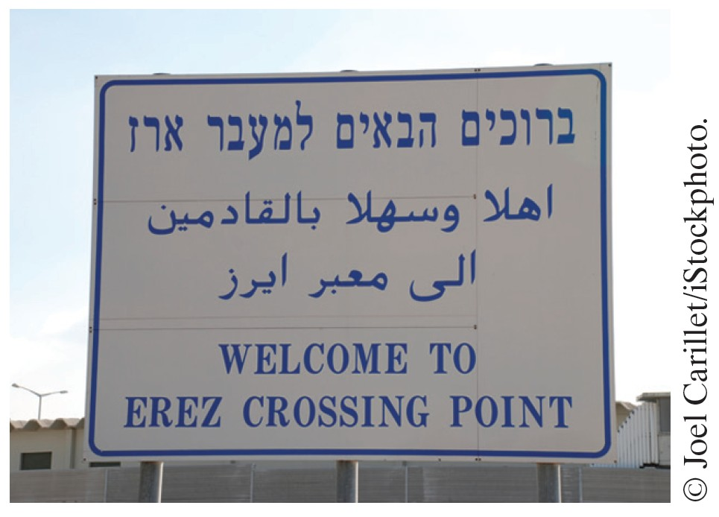
Hebrew, Arabic, and English

Slide 80
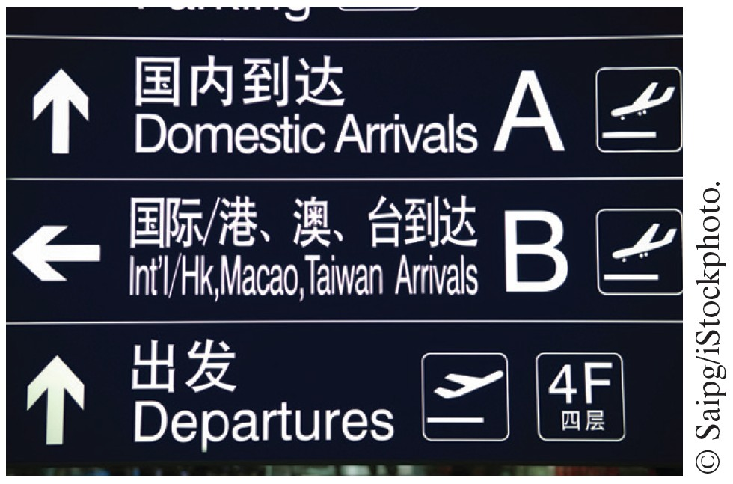
Chinese Script

